Slide 1
ELEN7046: Data Visualization – Big Data
Presenter: Group 2
Date: 22 June 2016
Group 2:
Sidwell Mokhemisa 1229756 Dave Cloete 1573016
Kyle Trehaeven 0602877N Gareth Stephenson 778919
Matsobane Khwinana 779053

Slide 2
Sidwell Mokhemisa

Slide 3
Agenda
Context
Project Organization
Lifecycle Method: IBM RUP
Architecture
Detailed Design
Summary of Used Technologies
Conclusion
Demo and Q & A

Slide 4
Context
Big Data Acquisition
Processing
Technologies
Visualization
Acquisition of Elections related data from Twitter (US and RSA).
Validation of tweet Location.
Raspberry Pi 3 Cluster.
Map-Reduce applied to process large set of data.
D3 Charts used for visualization of big data.

Slide 5
Project Organization
Dave Cloete
Overall PM
UX Design – Visualization
Sidwell Mokhemisa
Development Method
Architecture
Kyle Trehaeven
Big Data Acquisition
Streaming
Matsobane Khwinana
Big Data Acquisition
Batch - History
Gareth Stephenson
Big Data Processing
MAP Reduce

Slide 6
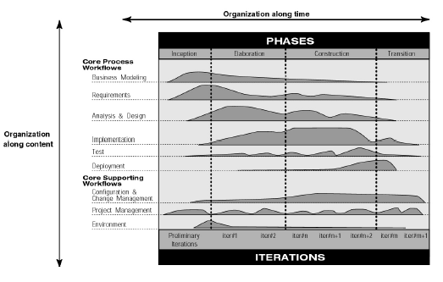
Lifecycle Method: IBM RUP

Slide 7
Lifecycle Method: IBM RUP (Tailoring Process)
Core-Process Workflows | Elaboration Phase | Tailoring
Business Model
Requirements | A Use-Case Model | T
 | Supplementary Requirements Capturing (NFR) | T
Analysis and Design | A Software Architecture Description | I
Implementation | An Executable Architectural Prototype | T
Test
Deployment
Core Supporting Workflows | Elaboration Phase | Tailoring
Config & Change Management | A Preliminary User Manual (Optional) | N/A
Project Management | A Revised Risk List and business case | T
 | A development plan for overall project | T
 | An Updated development case specifying process to follow | T
Environment
T = Tailored
N/A = Not Delivered
I = Included

Slide 8
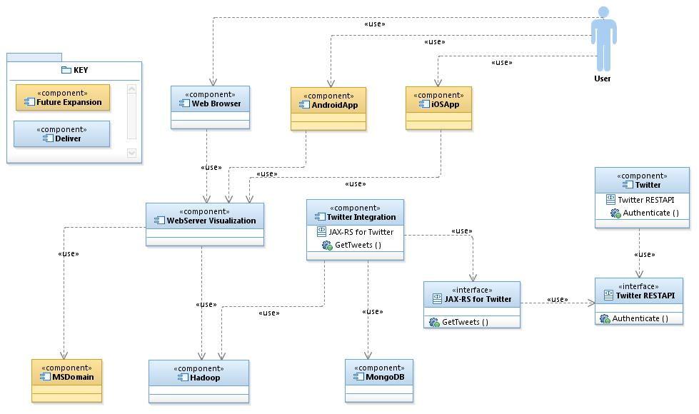
Architecture: High Level Component Model
User shall connect to the data visualization front-end using a browser
Back-End service shall be exposed using .NET and IIS to present data to the user and to query Hadoop
Twitter data shall be persisted here and user(s) will query it/ subscribe to a topic
This component will be used to get twitter data/ streams
Twitter will be the main source of our big data for the project.
MongoDB will be used as temporary storage for the data before it is moved to Hadoop
1
5
2
4
3
6

Slide 9
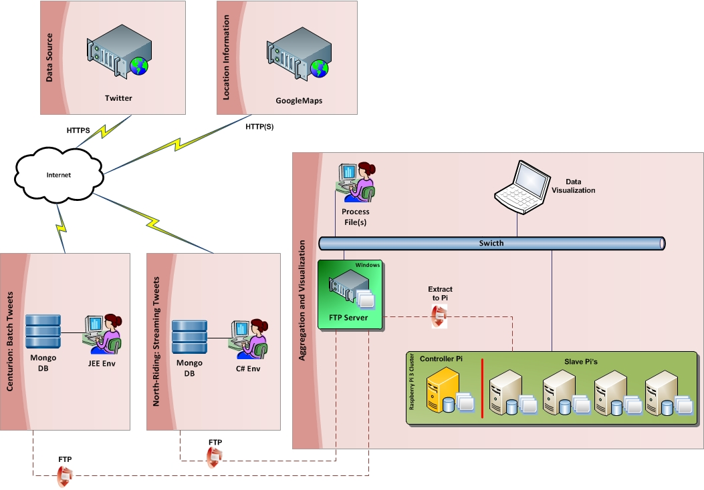
Architecture: Infrastructure Design

Slide 10
Matsobane Khwinana

Slide 11
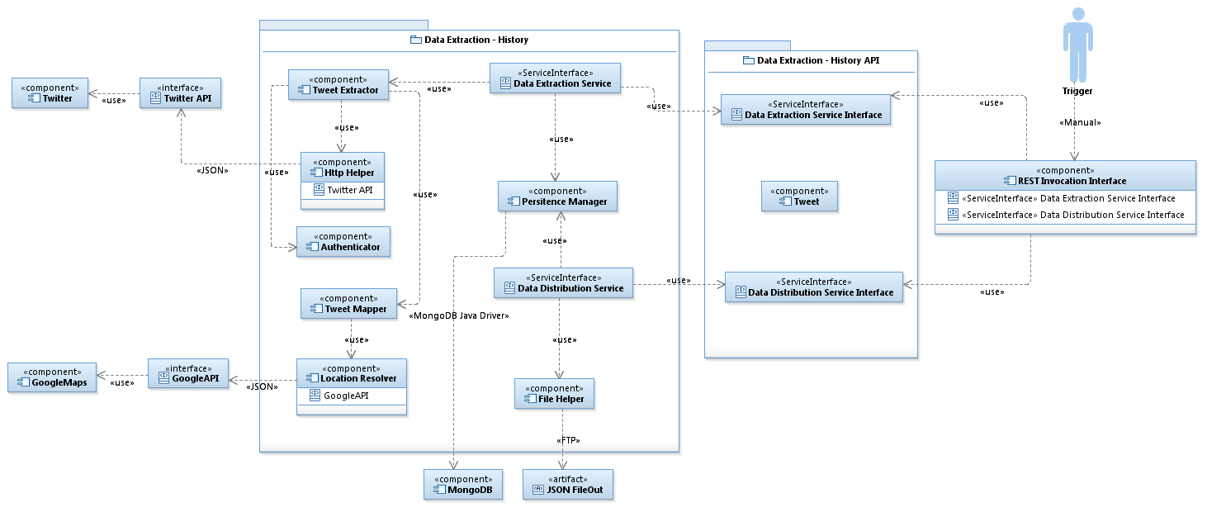
Detailed Design: History/ Batch Data

Slide 12
Kyle Trehaeven

Slide 13
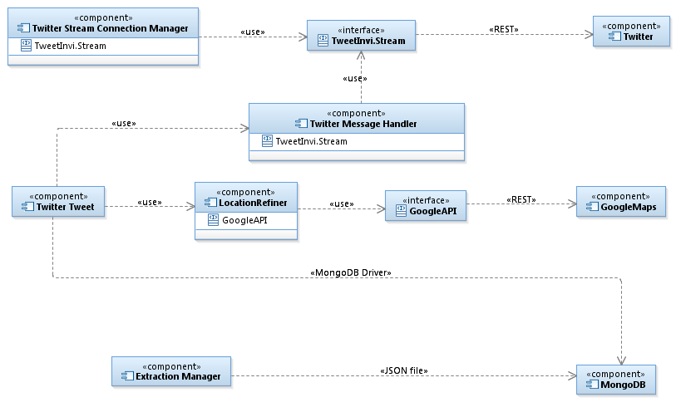
Detailed Design: Streaming Data
User shall connect to the data visualization front-end using a browser
Back-End service shall be exposed using .NET and IIS to present data to the user and to query Hadoop
Twitter data shall be persisted here and user(s) will query it/ subscribe to a topic
This component will be used to get twitter data/ streams
Twitter will be the main source of our big data for the project.
MongoDB will be used as temporary storage for the data before it is moved to Hadoop

Slide 14
Gareth Stephenson

Slide 15
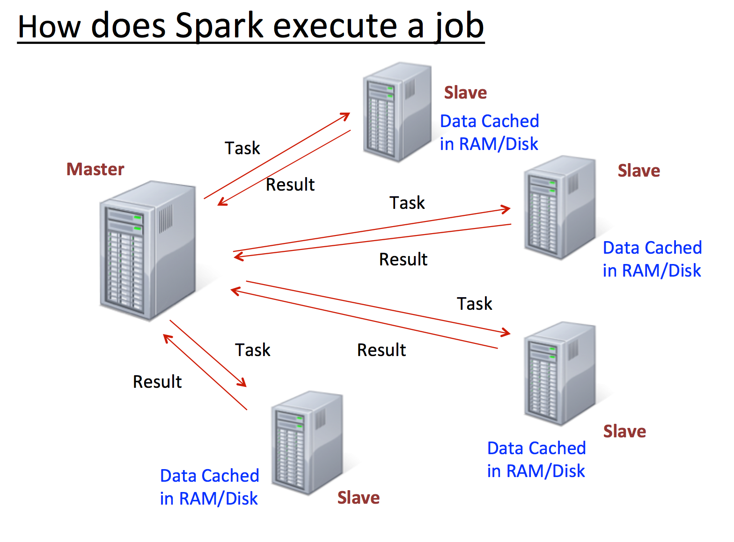
Detailed Design: Data Processing (MAP Reduce)
User shall connect to the data visualization front-end using a browser
Back-End service shall be exposed using .NET and IIS to present data to the user and to query Hadoop
Twitter data shall be persisted here and user(s) will query it/ subscribe to a topic
This component will be used to get twitter data/ streams
Twitter will be the main source of our big data for the project.
MongoDB will be used as temporary storage for the data before it is moved to Hadoop

Slide 16
Dave Cloete

Slide 17
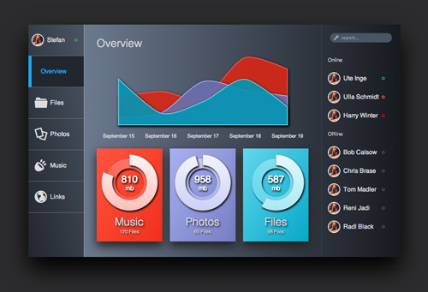
Detailed Design: Data Visualization (UX)
User shall connect to the data visualization front-end using a browser
Back-End service shall be exposed using .NET and IIS to present data to the user and to query Hadoop
Twitter data shall be persisted here and user(s) will query it/ subscribe to a topic
This component will be used to get twitter data/ streams
Twitter will be the main source of our big data for the project.
MongoDB will be used as temporary storage for the data before it is moved to Hadoop

Slide 18
Summary of Used Technologies
Technology | Usage Description in Context of Project
Raspberry Pi | Infrastructure for processing data and for running the Front-End (D3)
J2SE | Used for the development of data acquisition from Twitter using the Twitter batch API.
C# | Used for the development of data acquisition from Twitter using the Twitter streaming/ online API.
Mongo DB
D3

Slide 19
Conclusion

Slide 20
Referenced Material

Slide 21

Demo and Q & A

